Slide 1
Robots – Theory
How Robots can be used?

Slide 2
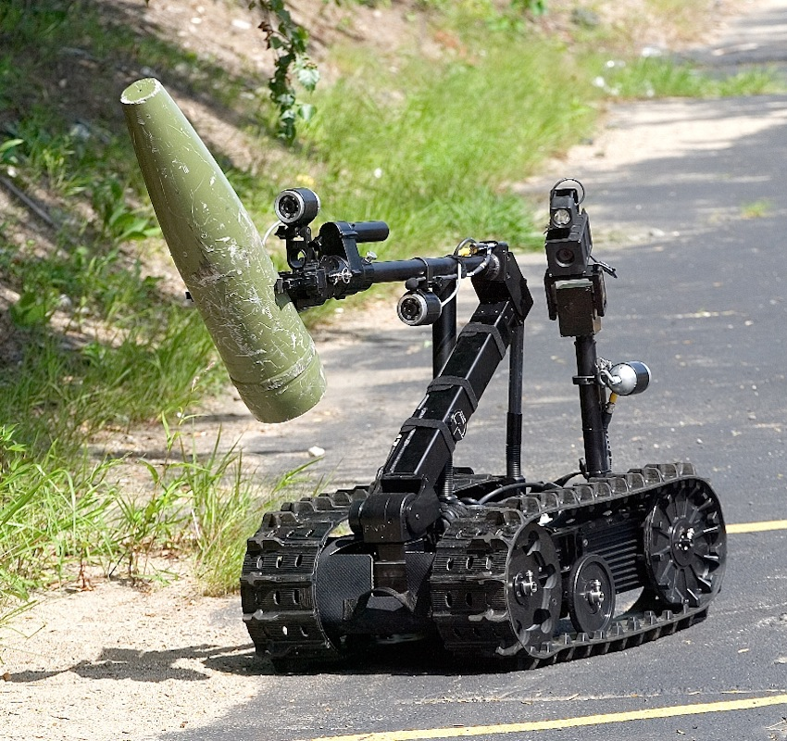
Introduction
Most robots today are used to do repetitive actions or jobs considered too dangerous for humans.
A robot is ideal for going into a building that has a possible bomb, explore other planets or simple things like build cars and electronics .

Slide 3
Why Use Robots?
According Idaho Public Television The reason robots are used is that it is often cheaper to use them over humans, easier for robots to do some jobs and sometimes the only possible way to accomplish some tasks! Robots can explore inside gas tanks, inside volcanoes, travel the surface of Mars or other places too dangerous for humans to go where extreme temperatures or contaminated environments exist.

Slide 4
Why Use Robots?
Robots can also do the same thing over and over again without getting bored. They can drill, they can weld, they can paint, they can handle hazardous materials, and in some situations, robots are much more accurate than a human ‐ which can cut back on production costs, mistakes or hazards. Robots never get sick, don't need sleep, don't need food, don't need to take a day off, and best of all they don't ever complain! There are a lot of benefits to using robots.

